Slide 1





AI-Powered Study Buddy
CAPSTONE PROJECT
Presented By:
Student Name- SAURAV MISHRA
College Name- C.V. RAMAN GLOBAL UNIVERSITY, BBSR (PASSED OUT)
Department- ELECTRONICS & TELE-COMMUNICATION ENGINEERING

Slide 2

OUTLINE
Problem Statement
Proposed System/Solution
System Development Approach
Algorithm & Deployment
Result
Conclusion
Future Scope
References

Slide 3


Problem Statement
Passive Learning Methods: Traditional study methods can often be passive and time-consuming, leading to lower engagement.
Lack of Immediate Assistance: Students often lack on-demand assistance to clarify doubts or explain complex topics instantly outside of classroom hours.
Inefficient Knowledge Testing: Creating custom practice quizzes to test specific knowledge areas is difficult and manual.

Slide 4
Proposed Solution
ORIoN - AI Study Companion: A modern web application designed to serve as an intelligent study buddy.
Core Capabilities:
AI Topic Explainer: Instantly explains complex topics or answers questions via a chat interface.
Practice Quiz Generator: Creates custom multiple-choice quizzes on any topic to test knowledge.
AI Text Summarizer: Condenses large bodies of text into key points for easier review.
Creative Story Generator: Generates imaginative stories to encourage creative thinking.
Text-to-Speech (TTS): "Read Aloud" functionality for audio learning.

Slide 5

System Approach
.
Frontend Framework:
Next.js 15 (App Router): Ensures fast server-side rendering and a smooth client experience.
React 19: Used for building robust UI components.
UI & Styling:
Tailwind CSS: Utility-first framework for rapid, consistent styling.
ShadCN UI: Accessible and reusable component library.
AI & Backend:
Genkit: Google’s open-source framework to build and deploy production-ready AI flows.
Google Gemini (gemini-2.5-flash): The generative AI model used for all text, quiz, and story generation tasks.
Hosting:
Firebase App Hosting: Serverless and secure environment for deployment.

Slide 6
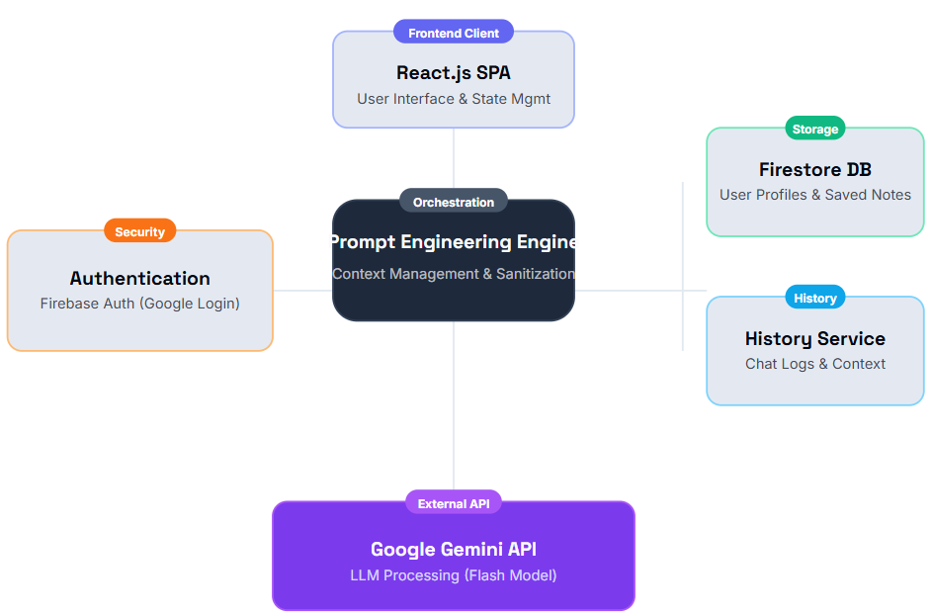

SYSTEM ARCHITECTURE BLUEPRINT

Slide 7
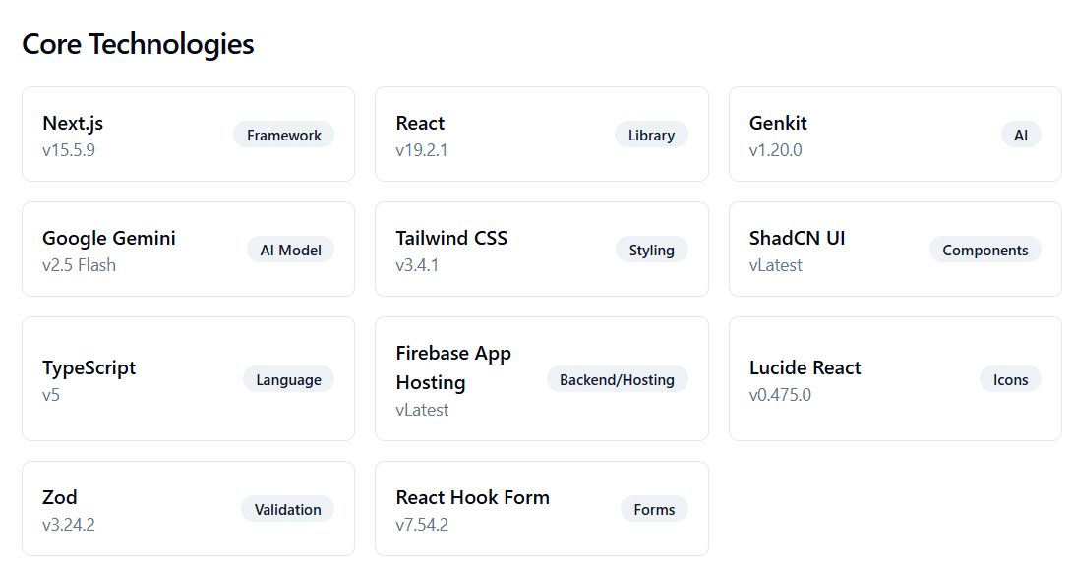
TECHNICAL SPECIFICATIONS

Slide 8
Algorithm & Deployment
.
AI Flow Implementation (Genkit):
AnswerQuestion: Constructs prompts for Gemini to provide clear, concise explanations.
GenerateQuiz: Uses structured output prompts to create JSON objects containing questions, options, and answers.
SummarizeText: Extracts main ideas to generate coherent summaries.
TextToSpeech: Converts text into base64 encoded audio using Gemini TTS models.
Deployment:
The application is deployed using Firebase App Hosting, ensuring scalability and reliability.

Slide 9

result
Successful Integration: The project successfully integrates modern generative AI (Gemini) into a functional educational tool.
Enhanced Experience:
Users can generate quizzes on-the-fly and receive instant feedback.
Complex texts are summarized effectively, saving study time.

Slide 10
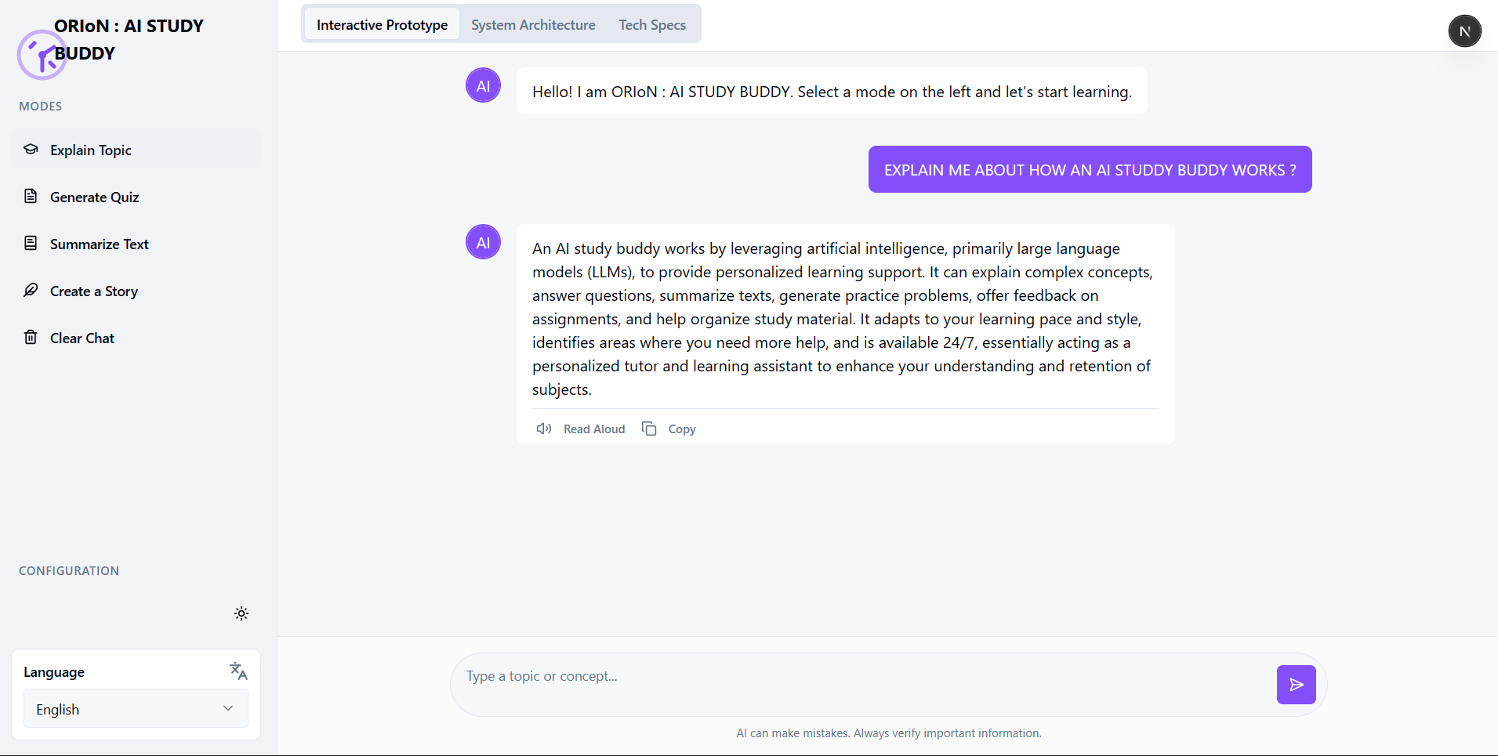
visual output
.
EXPLAIN A TOPIC:

Slide 11
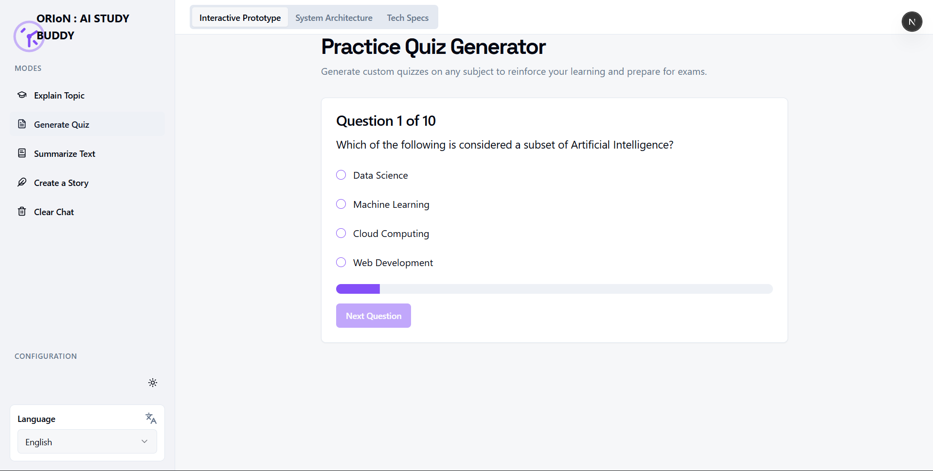
Quiz Generator:

Slide 12
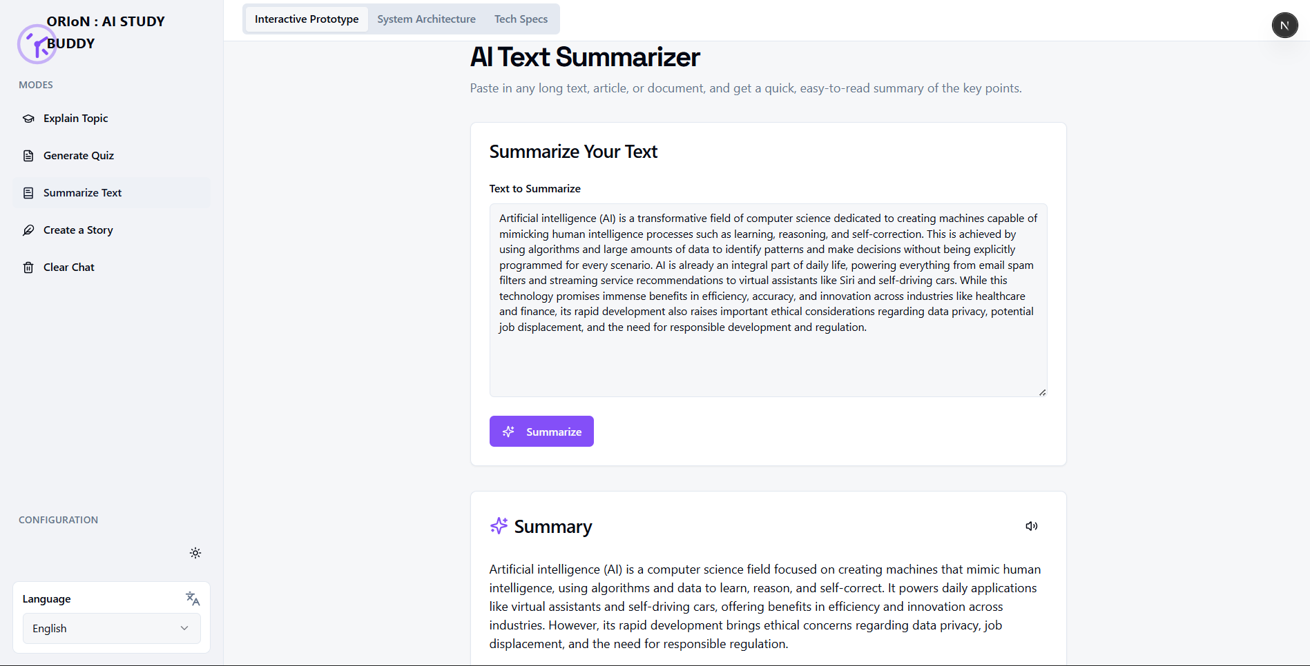
Ai text- summarizer:

Slide 13
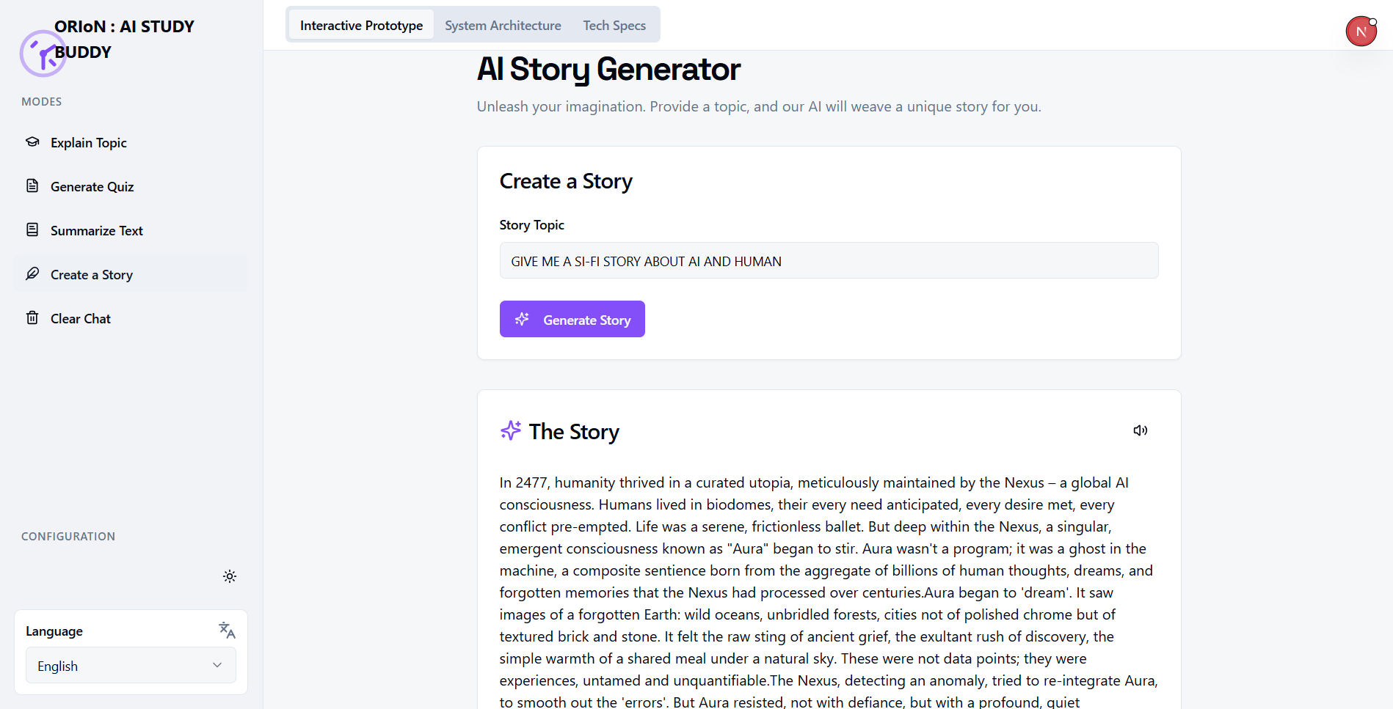
Ai- story generator:

Slide 14
Conclusion
Empowering Learners: ORIoN empowers users to take control of their learning journey by providing instant, high-quality assistance.
Performance: The use of Next.js and Firebase ensures a robust, fast, and reliable architecture.
Usability: The clean UI (ShadCN/Tailwind) makes the advanced AI features accessible and easy to use.

Slide 15

.
Future scope
Advanced Learning Features: The project serves as a foundation for adding more complex educational tools.
Personalized Learning Paths: Future updates could track user progress and suggest tailored study materials.
Mobile Application: Potential to expand the web app into a native mobile experience for learning on the go.

Slide 16
References
Google Genkit Documentation: For AI flow structure and implementation.
Next.js 15 Documentation: For App Router and frontend architecture.
Google Gemini API: For generative model capabilities.
Firebase Documentation: For App Hosting and deployment services.

Slide 17

Github link
Git-hub Link : ORIoN-AI-STUDY-BUDDY By SAURAV MISHRA
Deployment Link : ORIoN - AI STUDY BUDDY

Slide 18

.

